Slide 1

Debuggers
CEO/Lead Instructor: Brandon Dennis, OSCP

Slide 2
What is a Debugger?
Inspect the code as its running
Track Down errors
Modify the code while its running
Great for building exploits

Slide 3
Types of Debuggers
Ollydbg
Immunity Debug
GDB

Slide 4
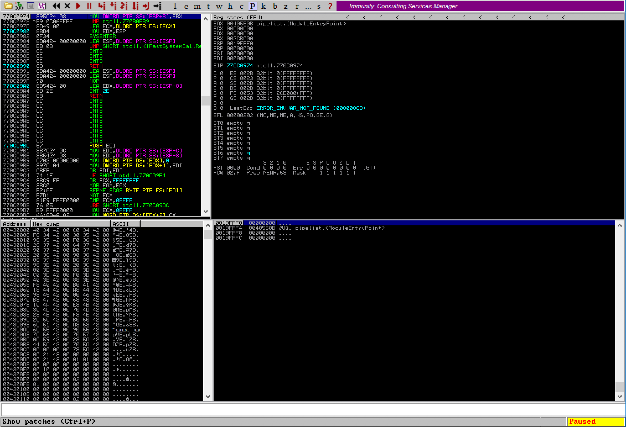
Common Layout for a Debugger
Execution Flow
Registers
Memory
The Stack

